Slide 1

Prof. Jonathan Chase
Advanced Community Ecology Course at Peking University
Lecture 6: Biodiversity and Ecosystems

Slide 2
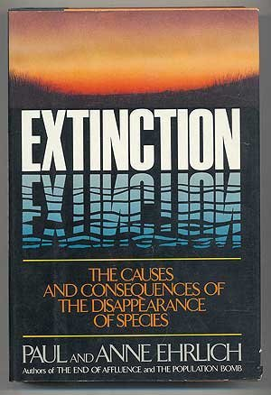
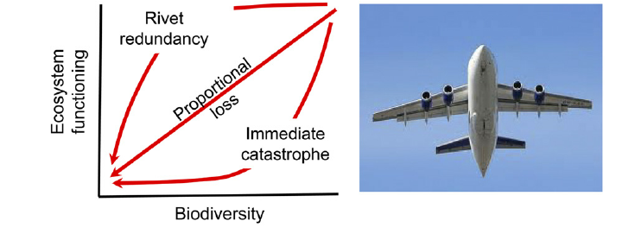

Slide 3
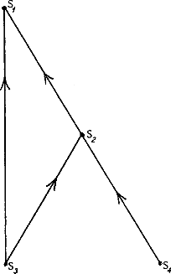
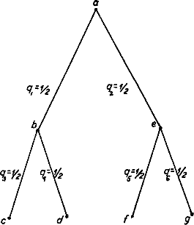
Biodiversity and Ecosystem Stability
“simple communities were more easily upset than that of richer ones; that is, more subject to destructive oscillations in populations, and more vulnerable to invasions”
C. Elton 1958
MacArthur 1955

Slide 4
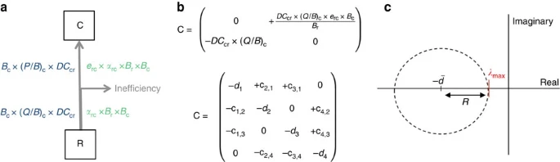
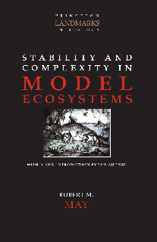
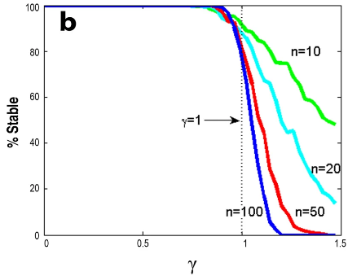
More diverse communities are less stable? Really?
Stone 2018

Slide 5
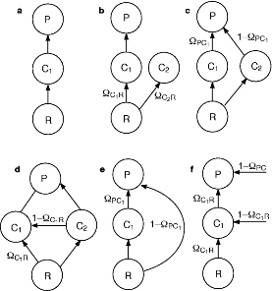
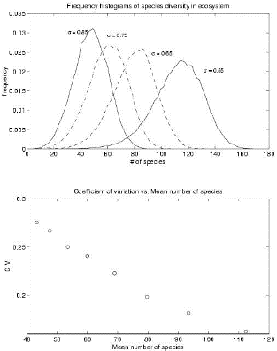
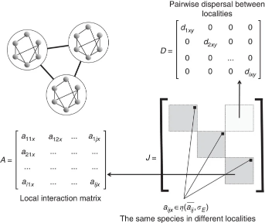

Slide 6
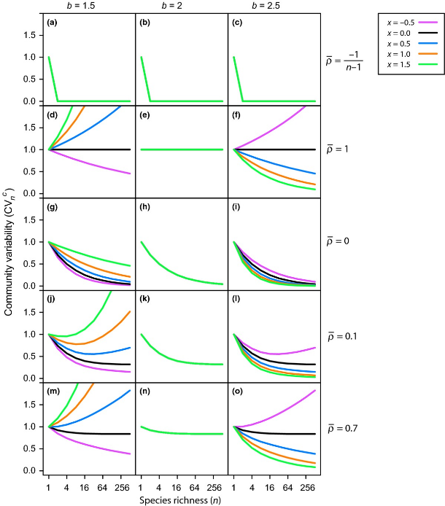
Understanding diversity–stability relationships: towards a unified model of portfolio effects
Thibault and Connolly 2013

Slide 7
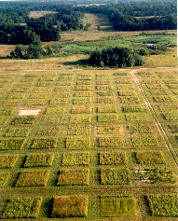
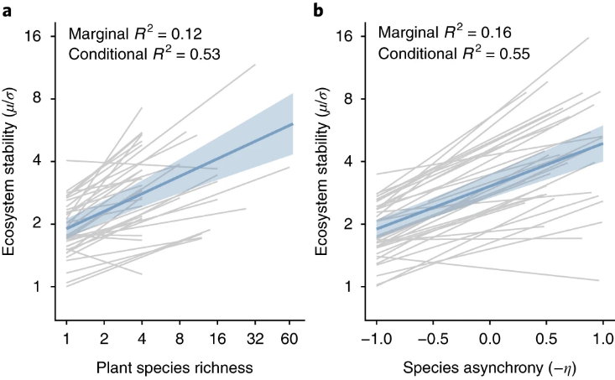
Multiple facets of biodiversity drive the diversity–stability relationship
Craven et al. 2018

Slide 8
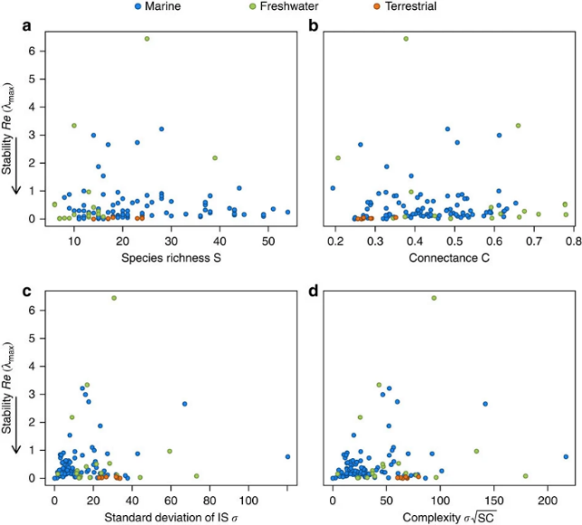
No complexity–stability relationship in empirical ecosystems
-Jaquet et al. 2016. Nature Communications

Slide 9
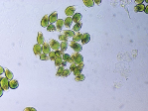
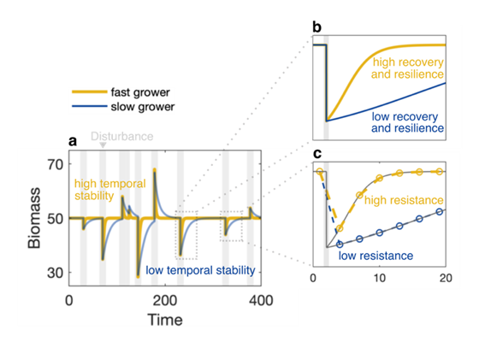
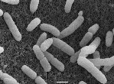
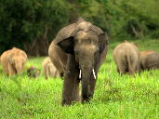
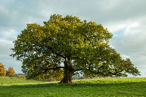
Intrinsic differences can ‘appear’ to differ in stability
Mentges et al. unpublished

Slide 10
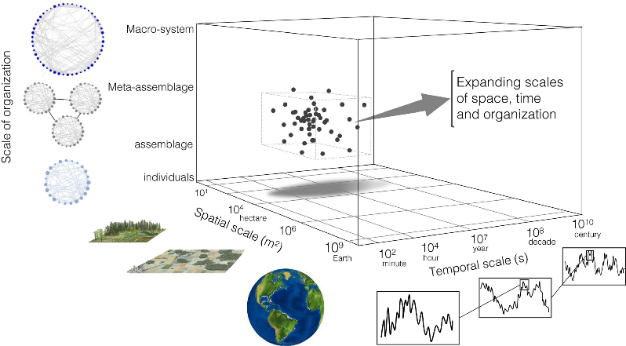
Spatial and Temporal Scaling of Stability (and functioning)
Gonzalez et al. 2020 Ecology Letters

Slide 11
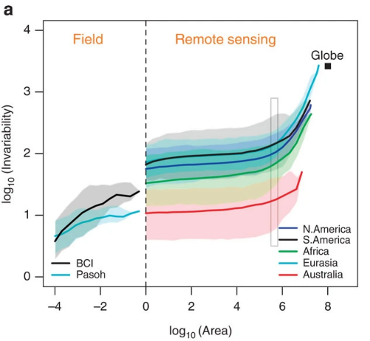
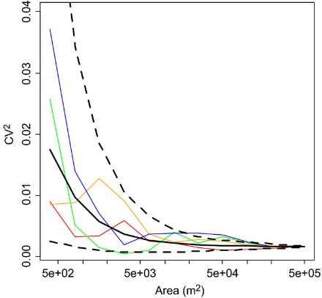
Stability-Scaling relationships
Wang and Loreau 2014 Ecology Letters
Wang et al. 2017 Nature Communications

Slide 12
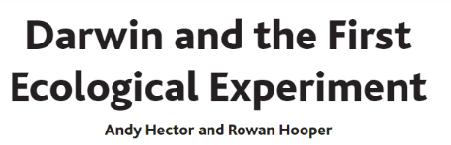
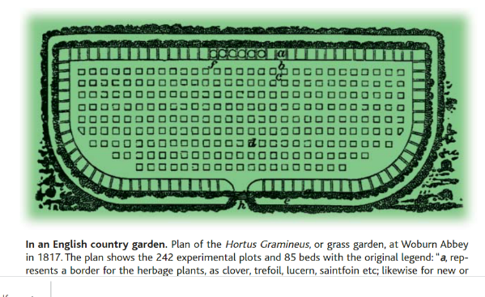
First Biodiversity-Ecosystem Functioning (BEF) Experiment
“A greater absolute amount of life can be supported…when life is developed under many and widely different forms,…the fairest measure of the amount of life being probably the amount of chemical composition and decomposition within a given period.”

Slide 13
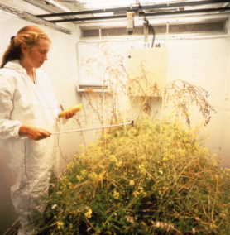
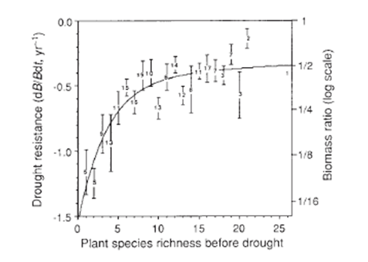
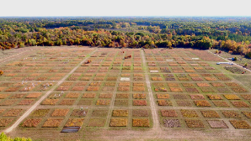
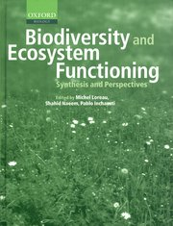
1990s—BEF becomes an idea

Slide 14
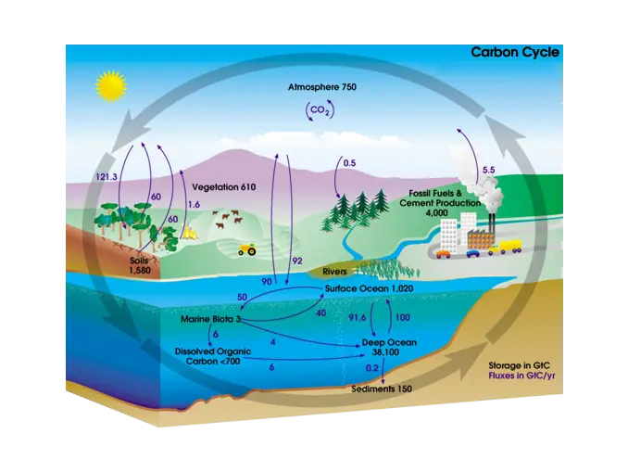
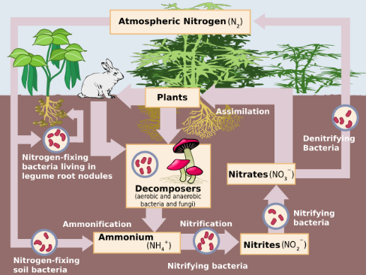
Ecosystem Models Ignore Species and Their Diversity

Slide 15
Ecosystem Functioning
‘Completeness’
Biomass
Productivity
Nutrient absorption
Abundance
Energy flux
Trophic diversity
Services
Carbon sequestration
Complexity
Images from the Noun Project
Networks & Webs

Slide 16
2010-2020s—BEF becomes a paradigm
Tilman 2014, Annu. Rev. Ecol. Evol.

Slide 17
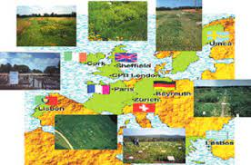
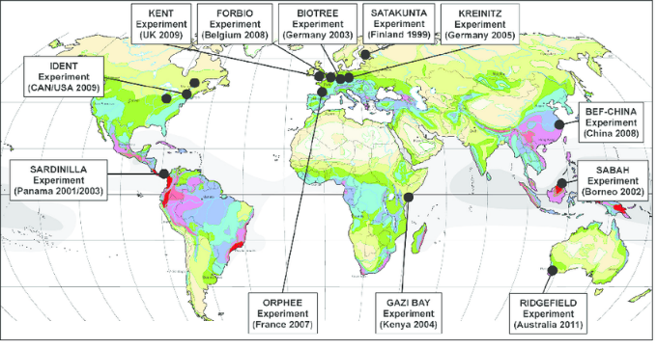
Networks of BEF experiments

Slide 18
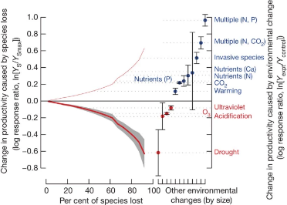
Hooper et al. 2012

Slide 19
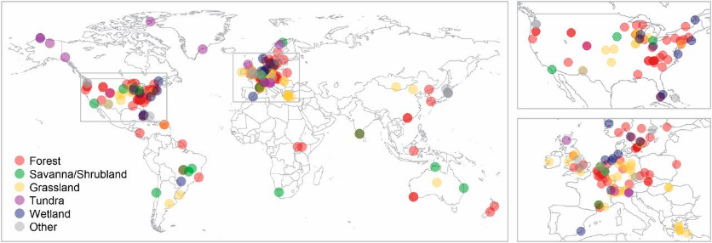
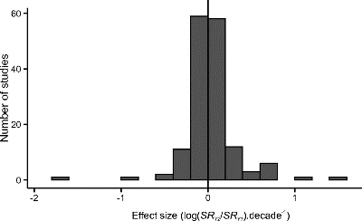
“We find no general tendency for local-scale plant species diversity to decline over the last century, calling into question the widespread use of ecosystem function experiments to argue for the importance of biodiversity conservation in nature.”
Vellend et al. 2013, PNAS

Slide 20
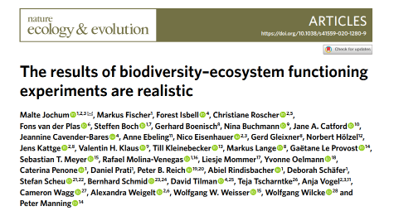
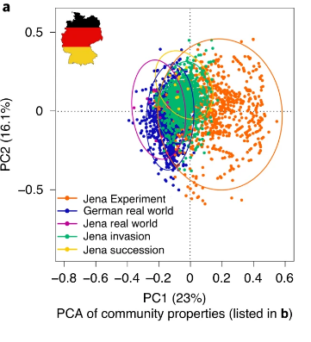
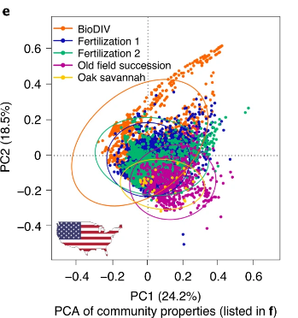
Sort of...

Slide 21
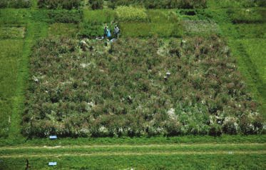
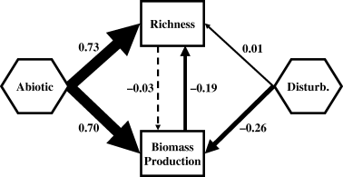
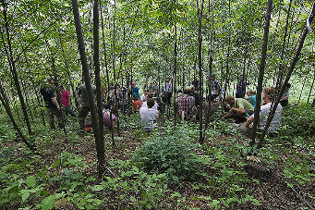
Which is cause and which is effect?
Species richness is not an ‘independent variable’
Grace et al. 2007, Ecology Letters

Slide 22
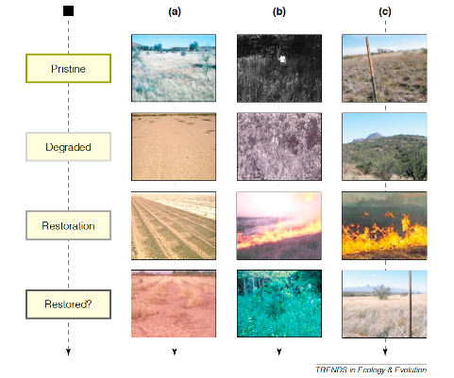
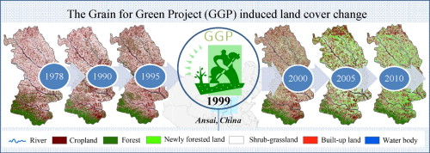
Restoration as an Experiment
Suding et al. 2004, TREE

Slide 23
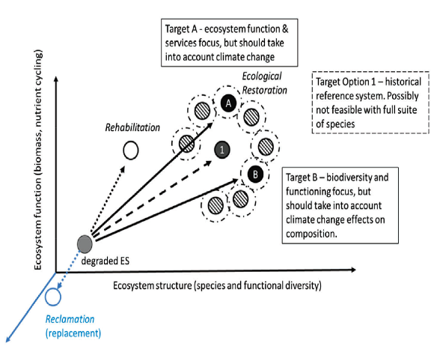


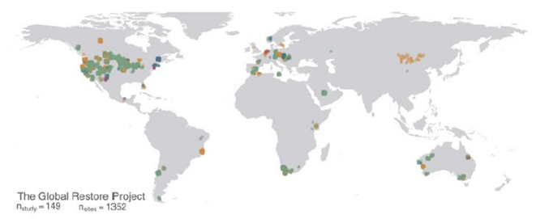
https://www.globalrestoreproject.com/
Temperton et al. 2019

Slide 24
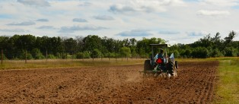
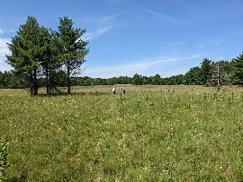
Biodiversity and Functioning Can recover after disturbance together
Isbell et al. 2019 NEE

Slide 25
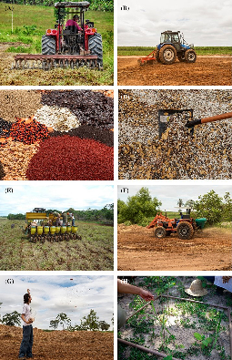
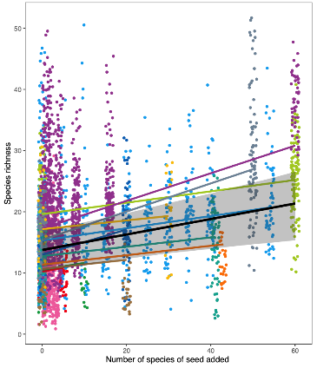
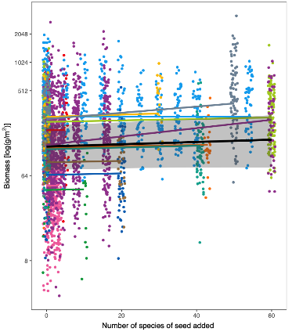


Or Responses can be decoupled
Ladouceur et al. 2020, Ecology Letters

Slide 26
As always….scale matters
Gonzalez et al. 2021 Ecology Letters
Gonzalez et al. 2021 Ecology Letters

Slide 27

As always….scale matters
Craven et al. 2020, Global Ecology Biogeography

Slide 28


Metacommunities and BEF
Community
Assembly and the
Functioning of
Ecosystems

Slide 29



Slide 30


Bannar-Martin et al. 2018

Slide 31

By tracking species Identities we can quantify gains and losses
Ladouceur et al. 2022, Ecology Letters

Slide 32




Slide 33

Fertilization, lose species richness→gain biomass

Slide 34



Slide 35
10 minutes—Break
10 minutes—Re-Read paper
20 minutes—Discuss in breakout groups (4)
Side 1: BEF Experiments are Important (Eisenhauer et al.)
(Group 1, 3) (no matter what you actually believe)
Side 2: BEF Experiments are Useless (Wardle)
(Group 2,4) (no matter what you actually believe)
20 minutes—Discuss in Full Group
Google Jamboard:
https://jamboard.google.com/d/1WkRQ0RrYTCSgo8V-3k34lnkg2pq4Fs6Lz1X_i9rFvIM/edit?usp=sharing

